Slide 1

Home Owl
Autonomous Security Robot
Samantha Buckle
Dylan Dauz
Sameeh Olipani
Sheldon Peters
Notes:
Sameeh

Slide 2
Problem
Homes, businesses, and facilities become vulnerable at night to break-ins or intrusions
On average, 3,062 burglaries happen in the U.S. every day
Full security systems are:
Semi-permanent
Costly
Can take time to install
Notes:
Sameeh

Slide 3
Project Goals
This project aims to design and build a robot for use in the monitoring of indoor spaces
Robot will be capable of:
Autonomous navigation of a building or room without the need for human control
Utilize sensors to detect loud noises or the presence of a person
Flash lights and play an alarm sound when disturbance is detected
Get signal from remote control to turn the system on and off
Notes:
sameeshjamigahaj

Slide 4
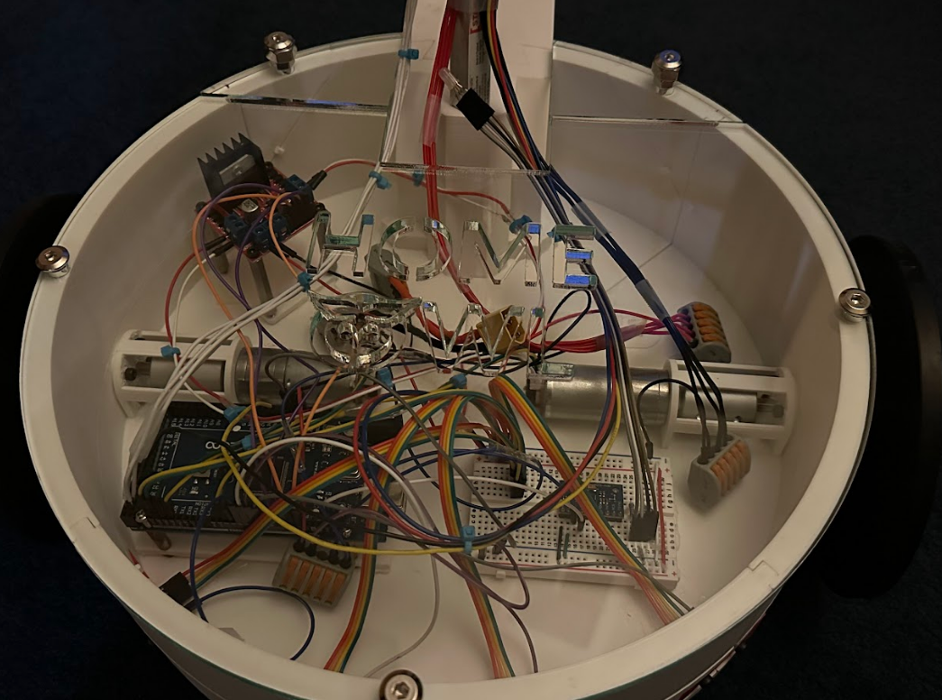
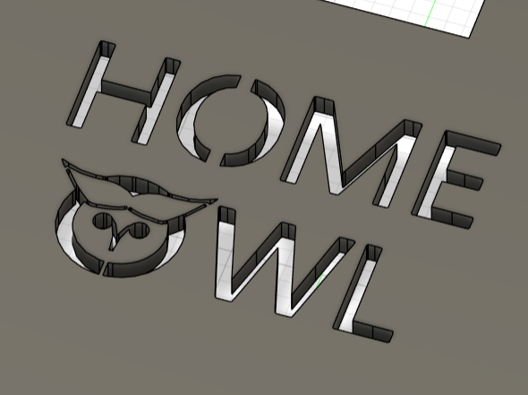
Finally Fixing Motor Problems
After exhausting multiple different options trying to get consistent PWM speeds and encoder ticks
We got new motors and motor controllers
Notes:
Samantha

Slide 5
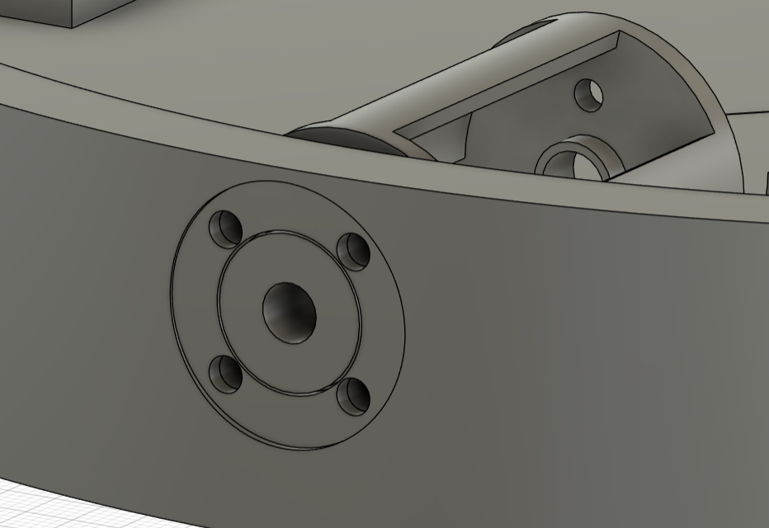
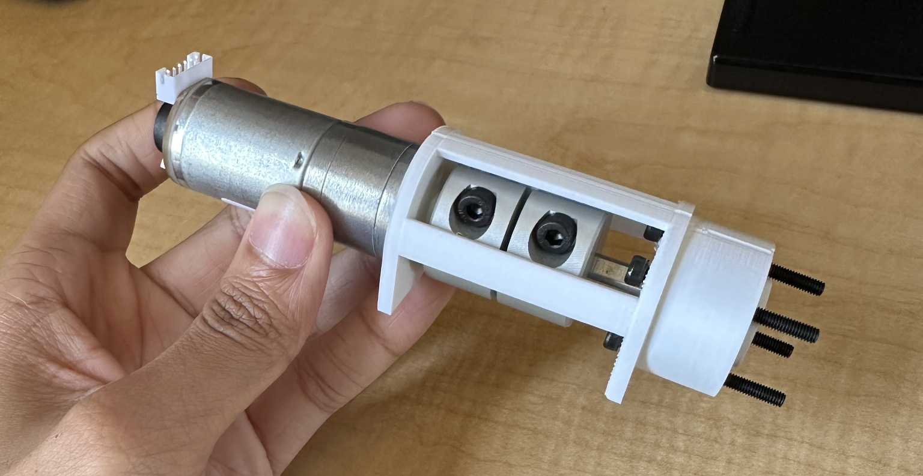
New Motor Mounts
Notes:
Dylan

Slide 6
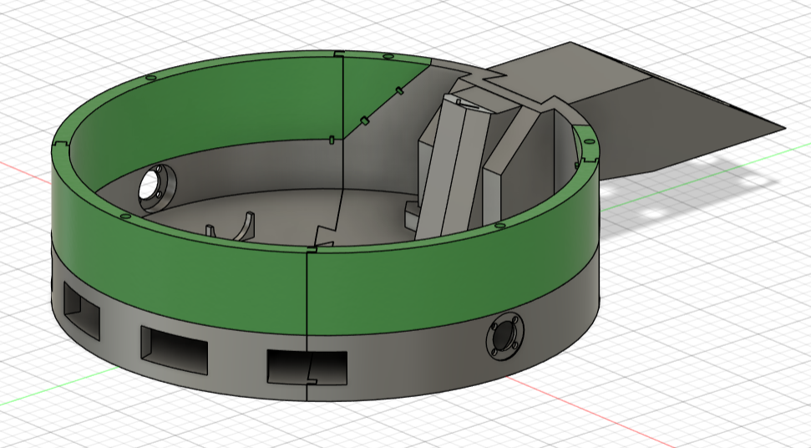
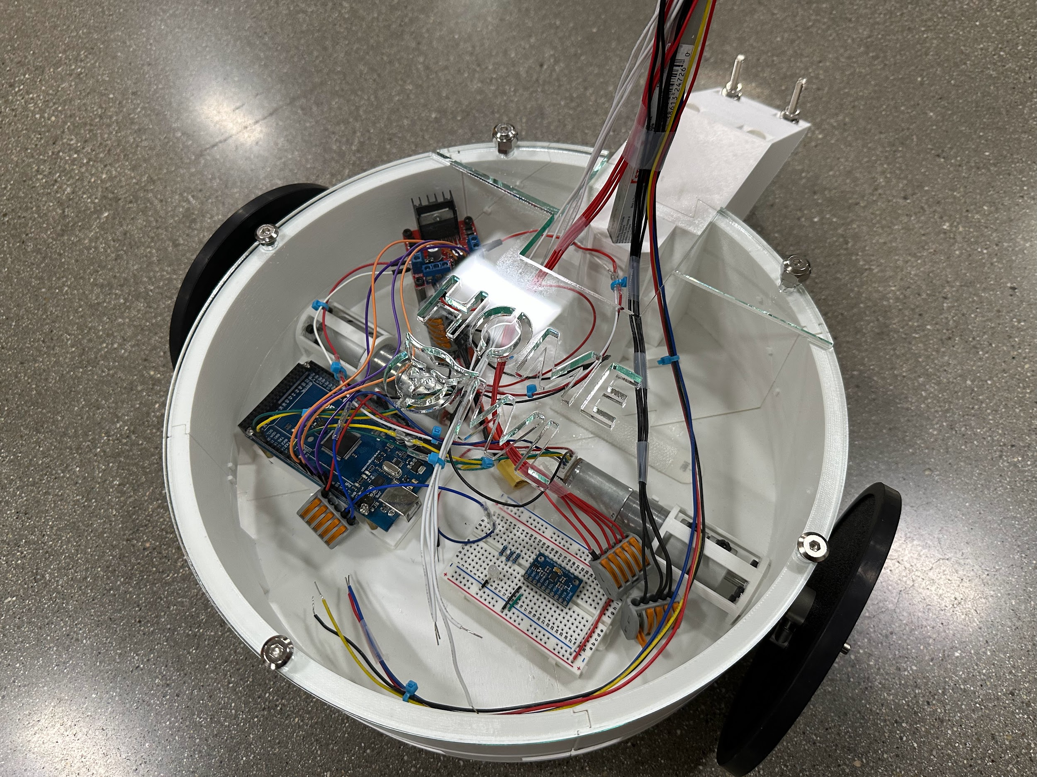
Structural Additions
Walls
Acrylic roof
Notes:
Dylan

Slide 7
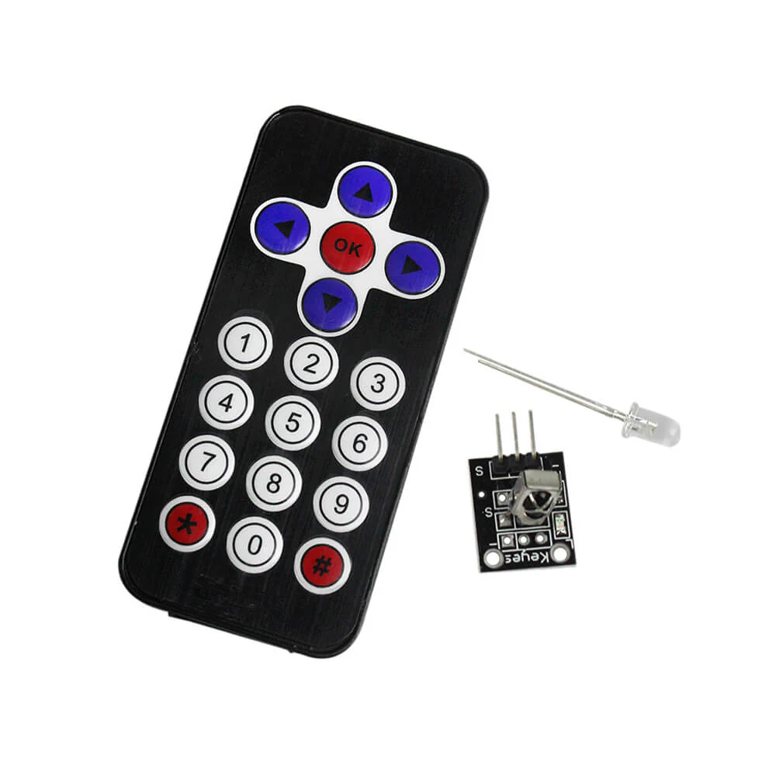
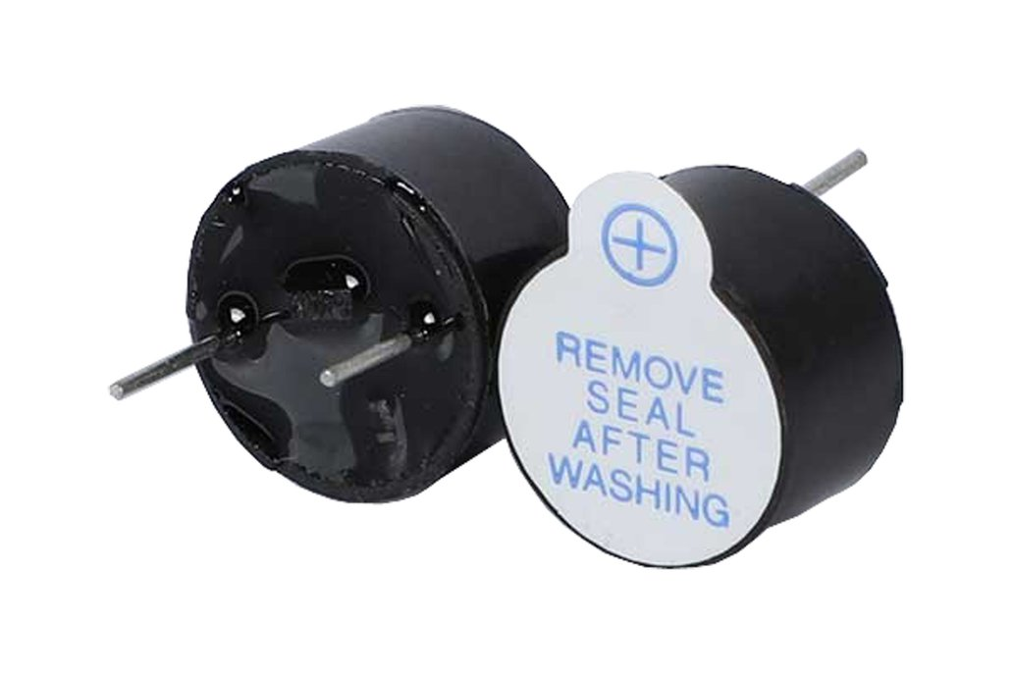
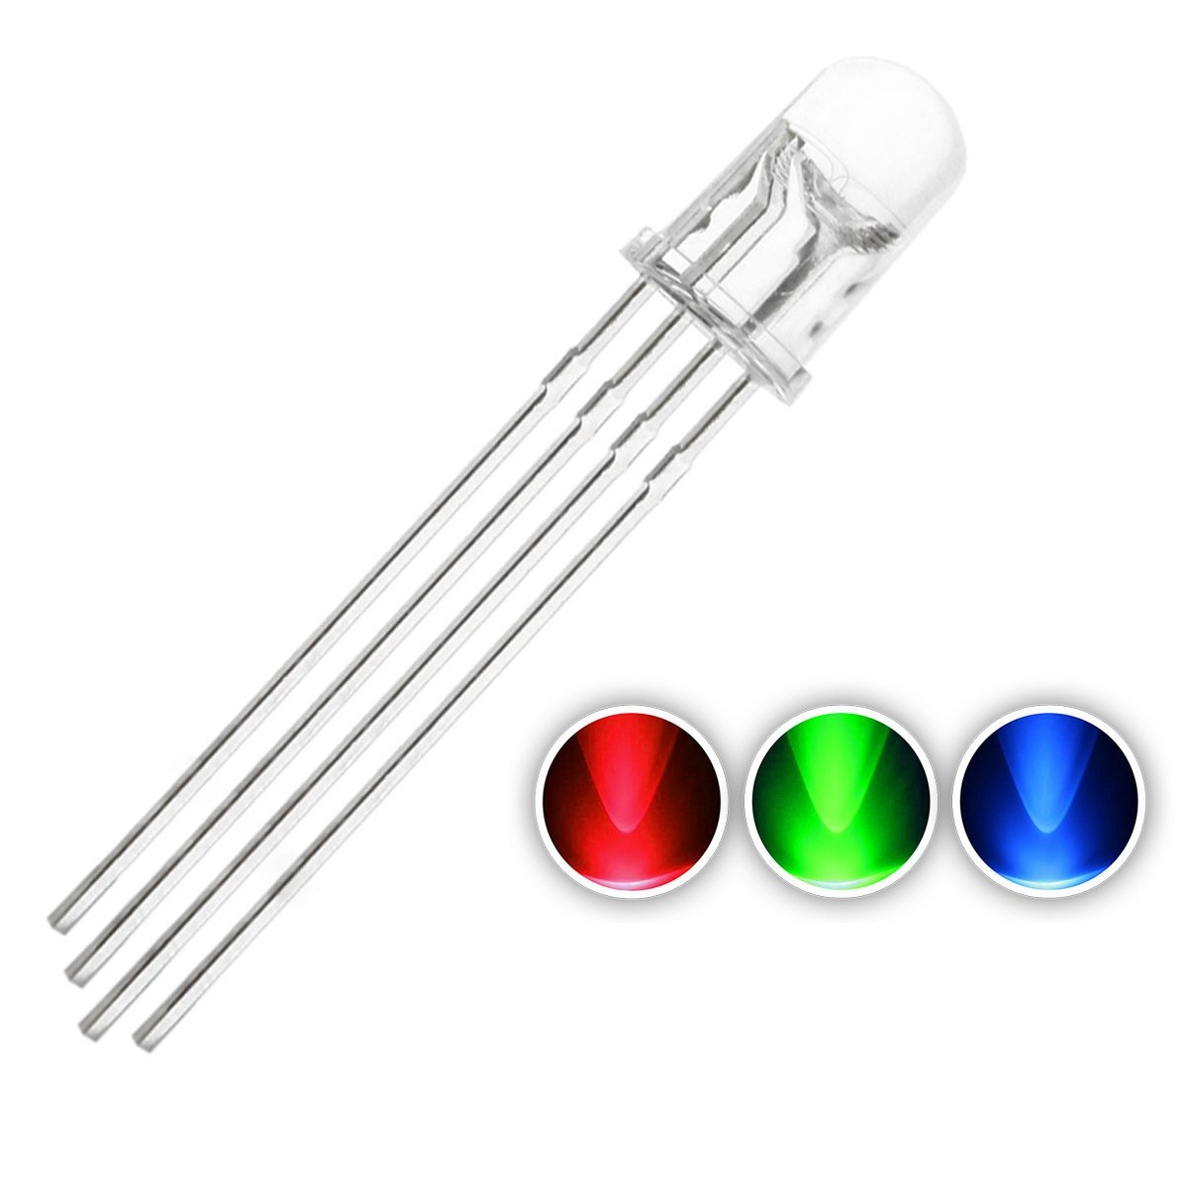
Newly Integrated Sensors
Active buzzer
Used to make sound for the robot’s alarm system
IR sensor
Used in combination with remote control to power on/off and reset the robot
RGB LED
Used to show what state the robot is in (like off, moving, searching, standby, and ect.)
Notes:
sheldon

Slide 8
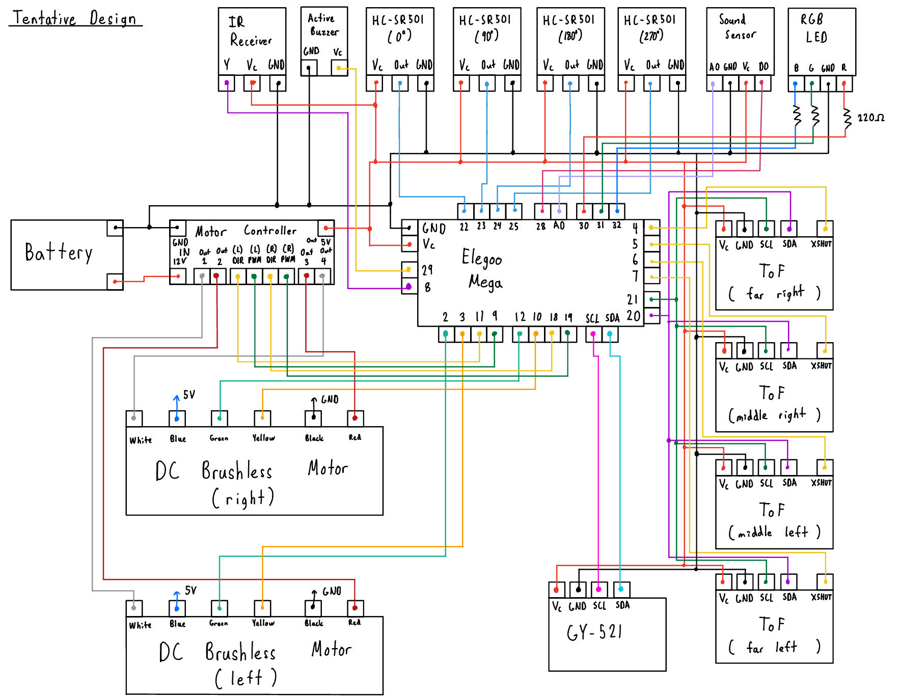
Wiring Diagram
Notes:
sheldon

Slide 9
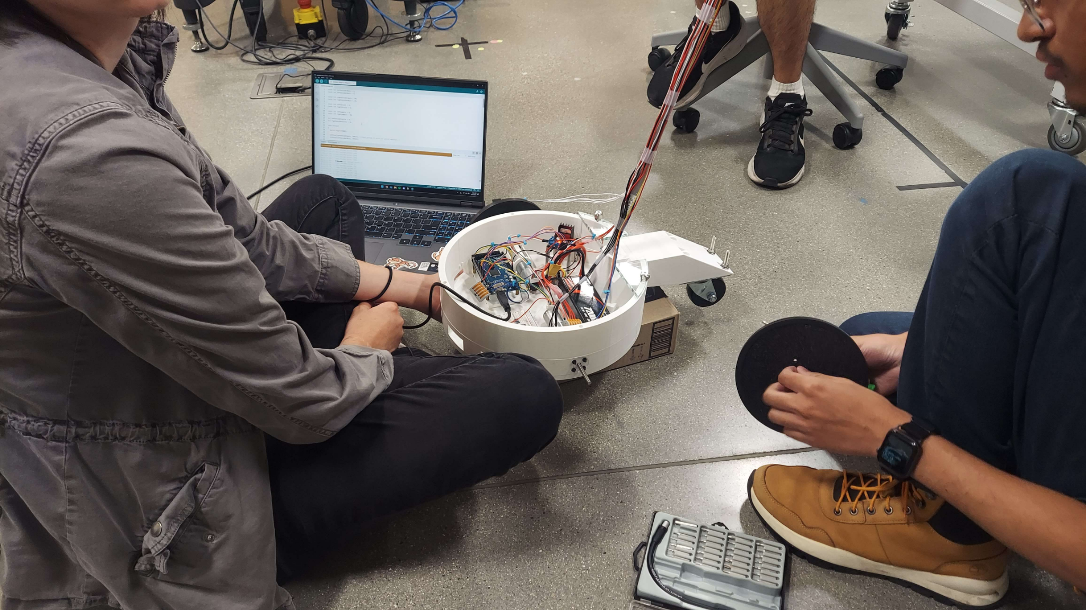
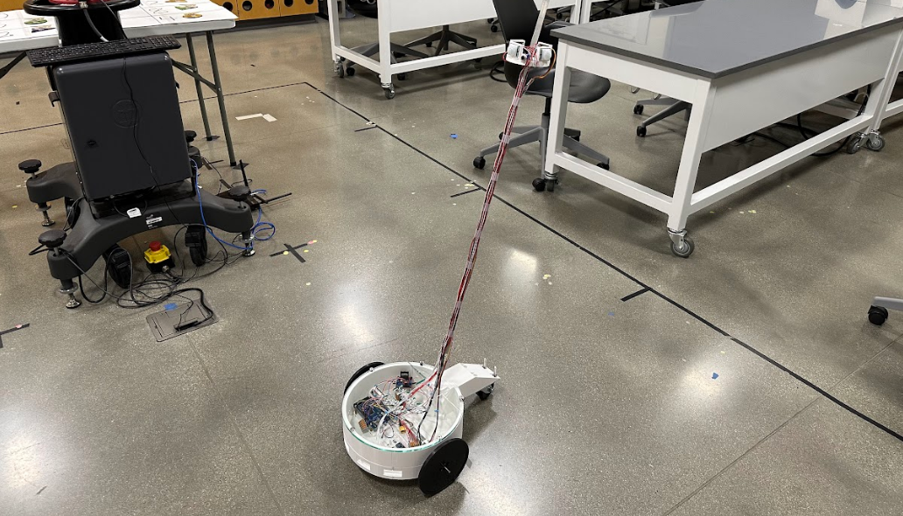
Some Pictures!
Notes:
Sameeh

Slide 10
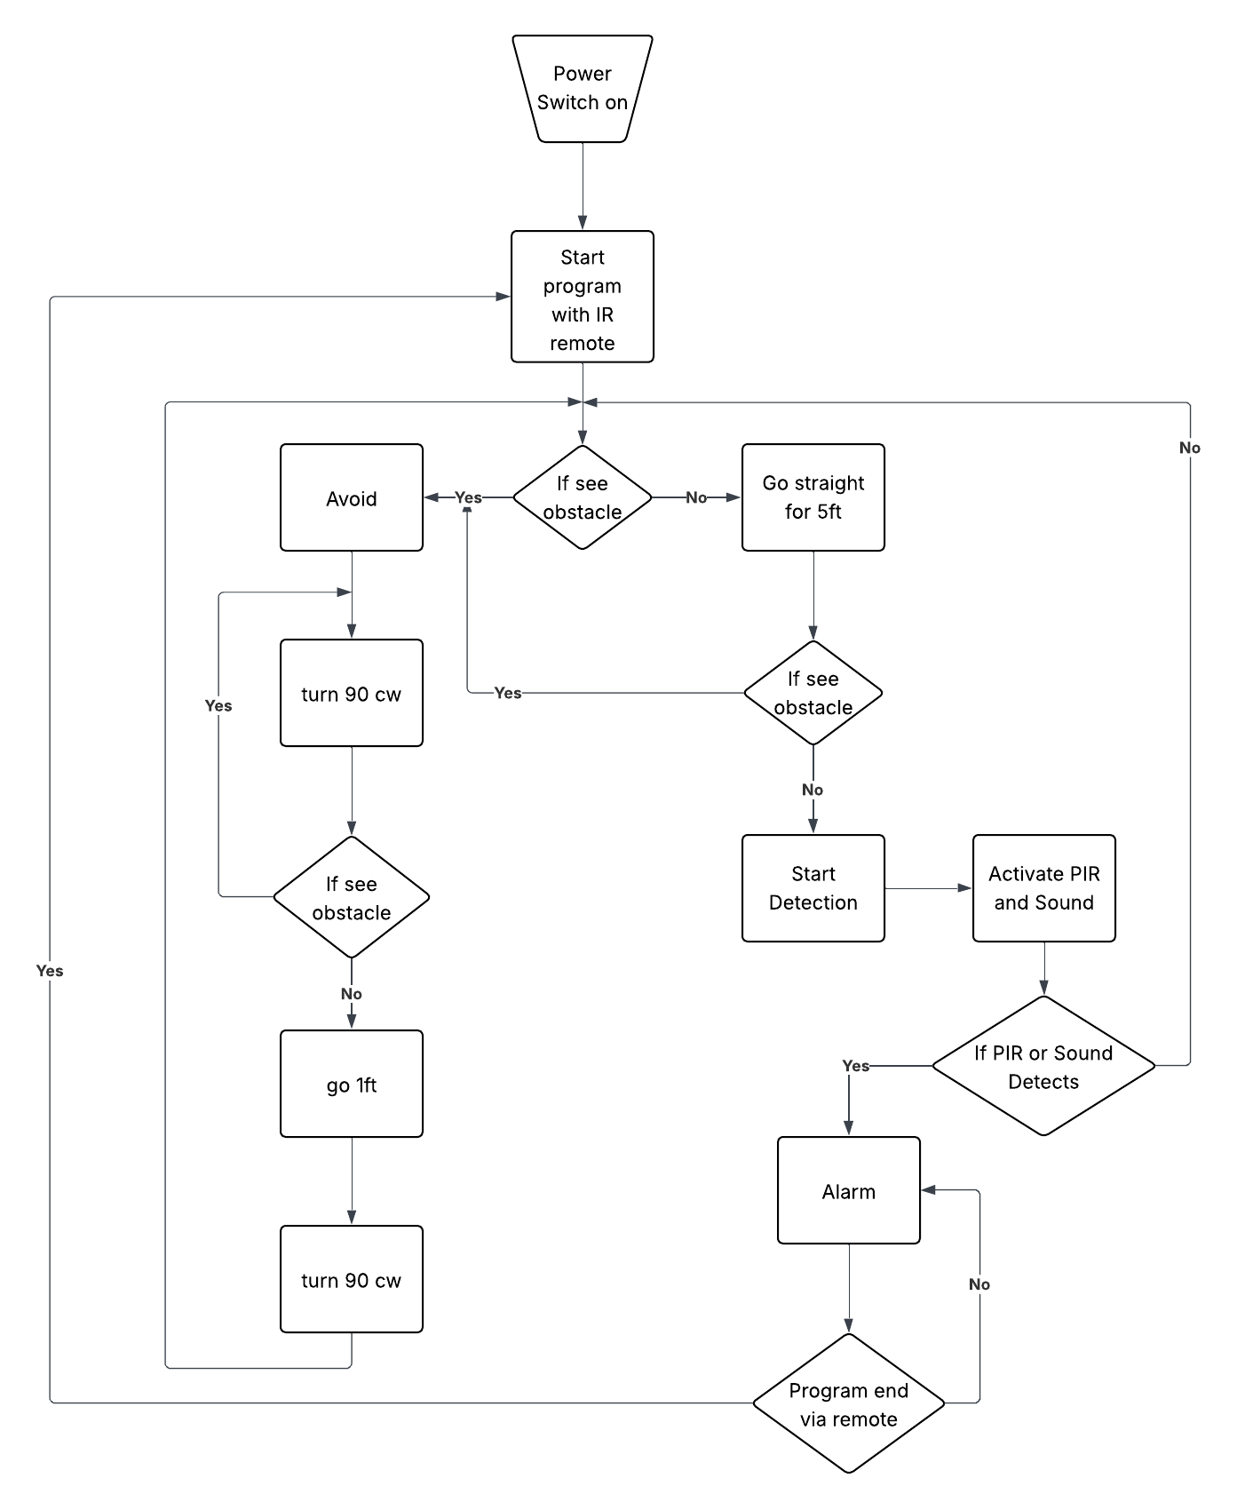
Program State Diagram

Slide 11

Next Steps
Finish implementing movement algorithm
Creating poster and website before deadline
Integrating multiple coding programs together
Sensor code and navigation code are currently being spliced together
Notes:
Samantha

